Slide 1
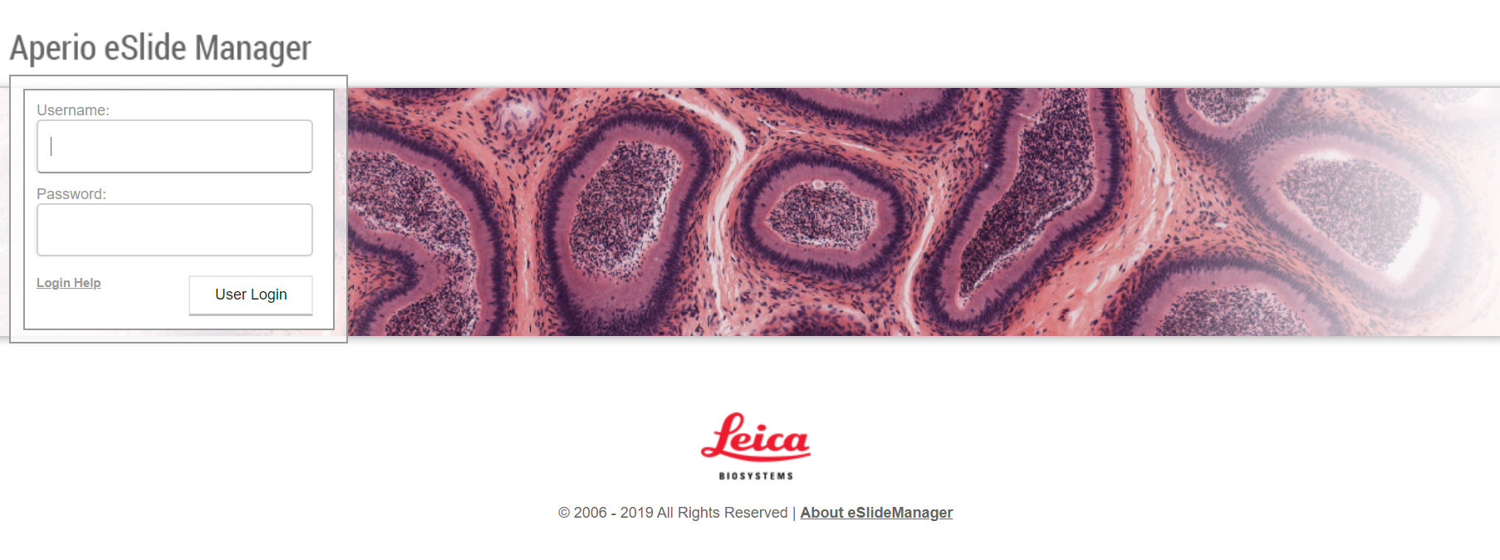
Start with https://lebourg.lfp.cuni.cz/Login.php page.
Note, from the faculty network only!!!
Login to the eSlide Manager:
Username: Student
Password: Student1
Then press “User login” button
Student
Student1

Slide 2
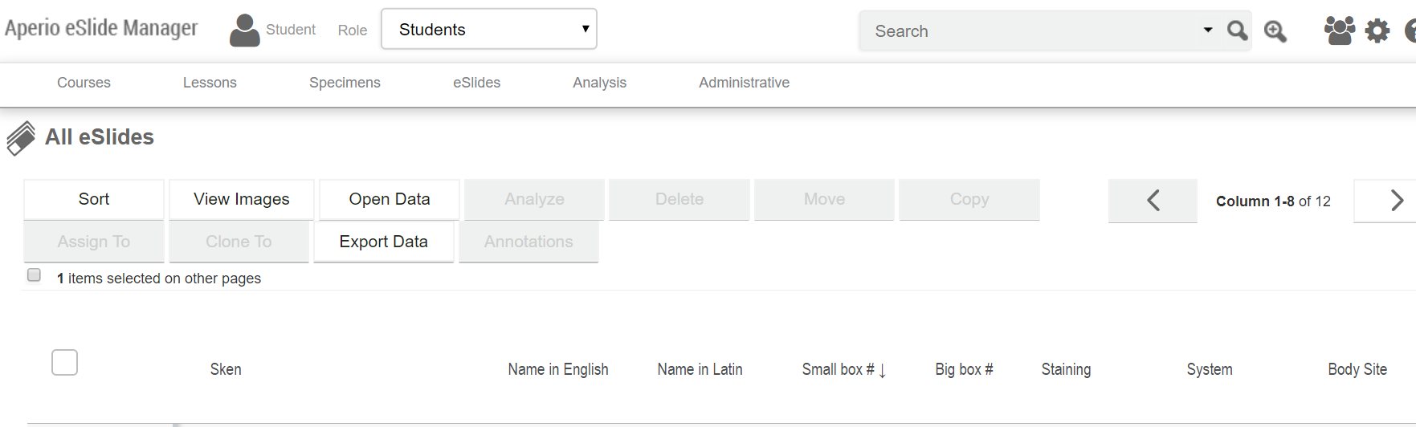
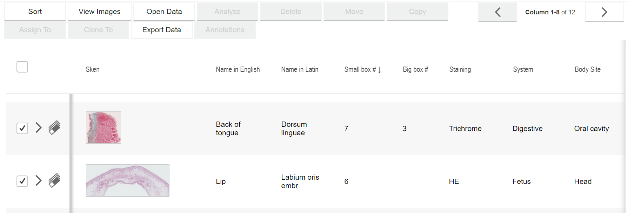
Sort the data using advantage sort or by selecting a data bars in depending on your preferences:
Select one or more skans and click a “View Images” button

Slide 3
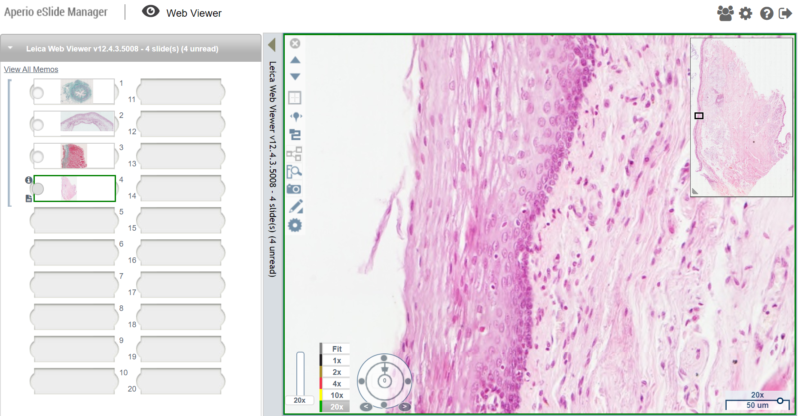
Now you can zoom and scroll through the selected section

Slide 4
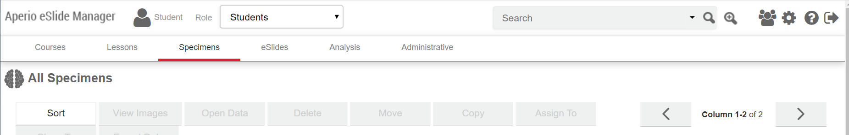
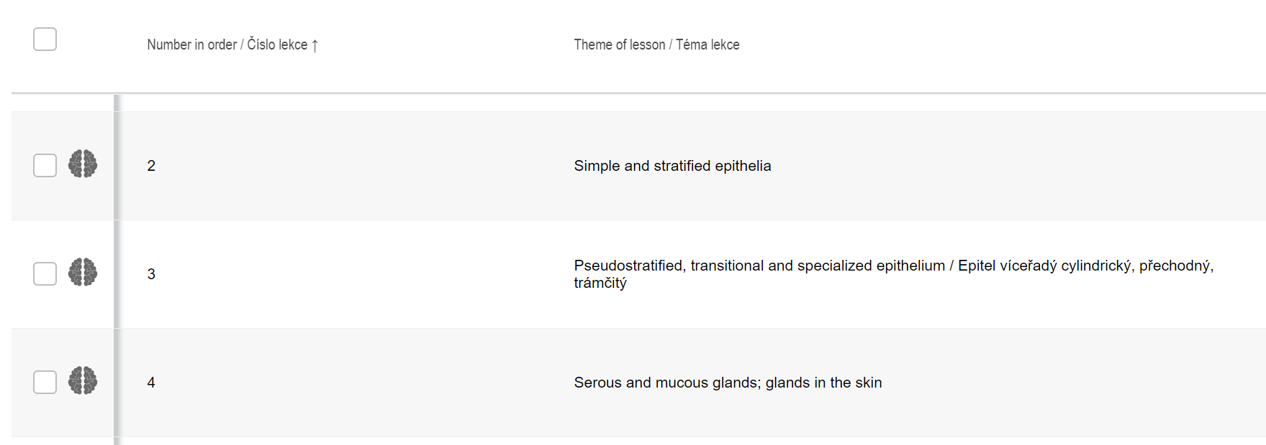
Other option is:
Select a “Specimens” button
You will be able to get to this section using the “Courses” or “Lessons” buttons as well.
Go to the respective specimen and select it using a “brain” button
Note that the order number of the specimen is respective to the summary of practical sessions (see our web-pages).

Slide 5
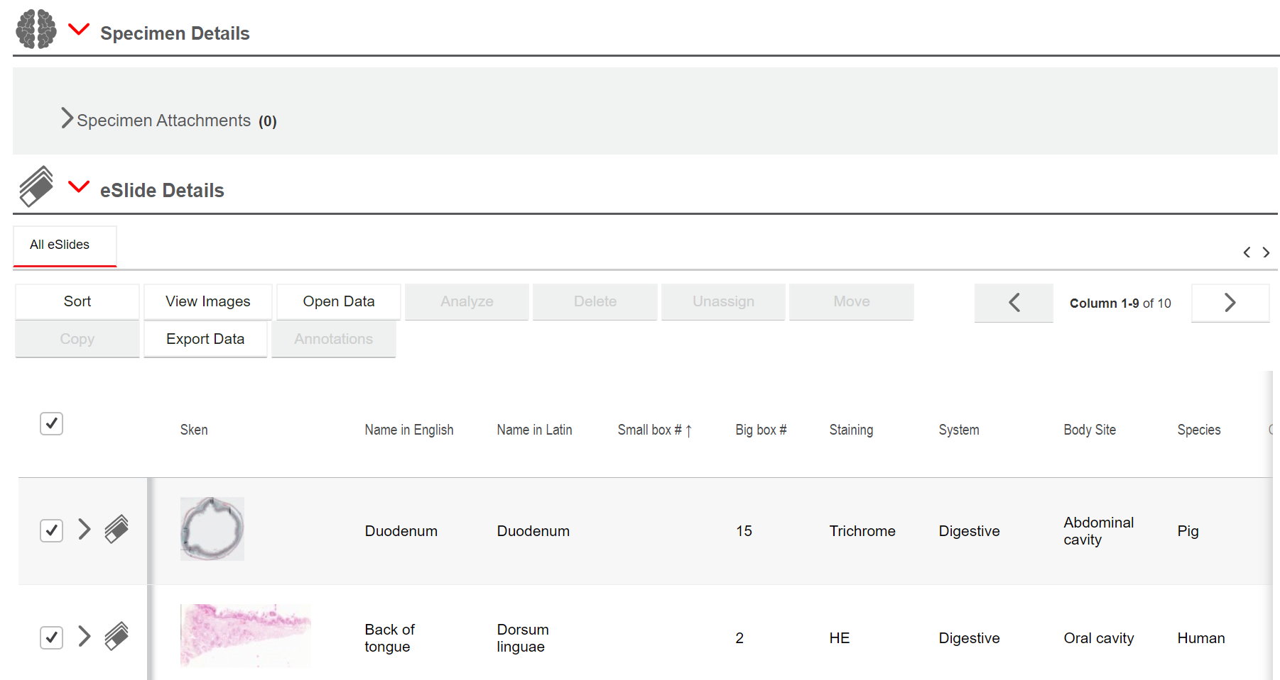
Scroll down through the small lesson description
Select the skans and click a “View Images” button

Slide 6
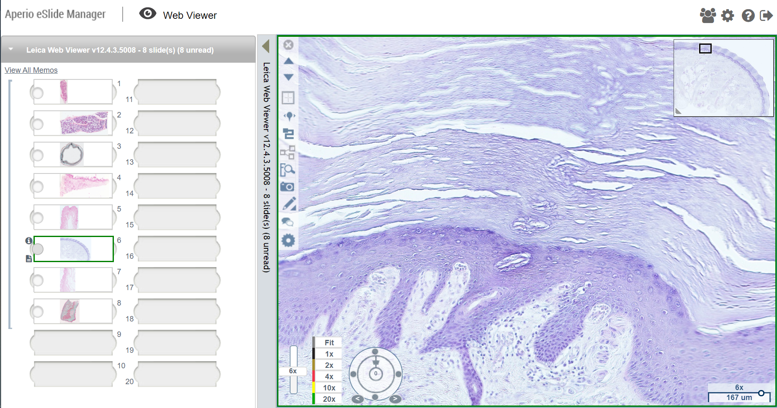
Now you can zoom and scroll through the selected sections as well.

Slide 7
Please, log out after finish your work
Have fun. Best.

